Slide 1





Problem solving with fractions and decimals
Task A: Solving problems with fractions
1) Arrange five different digits into these inequalities.
a)
b)
E.g.
7
9
5
>
>
2
3
E.g.
5
4
1
2
>
3
>
2) Arrange the digits 1 to 9 to make these inequalities true.
a)
b)
E.g.
8
6
4
2
1
>
9
>
7
>
5
>
3
E.g.
3
5
7
9
2
>
>
6
>
8
>
1
4
3) Izzy, Andeep, Lucas, Alex and Sam record their scores for a spelling competition.
Rank them from worst to best.
Izzy
Andeep
Lucas
Alex
Sam
Ranked:
Andeep, Lucas, Sam, Alex, Izzy

Slide 2




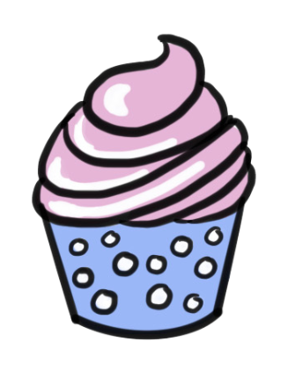

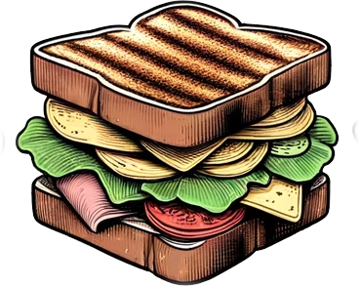
Problem solving with fractions and decimals
Task B: Solving problems with decimals
1) Here are the prices of some items in a cafe.
£1.58
£0.77
£1.95
£0.76
£1.54
£2.95
£1.98
Write them in order from cheapest to most expensive.
You have a £5.00 gift voucher but you won’t get any change.
You therefore want to spend as close to £5.00 as possible.
What can you buy?
A sandwich and a milkshake. Total cost = £2.95 + £1.98 = £4.93
What is the largest number of items you can buy with £5.00 and what are they?
An apple, a banana, a juice and a cupcake.
Total cost =£0.77 + £0.76 + £1.54 + £1.58 = £4.65
‹#›

Slide 3





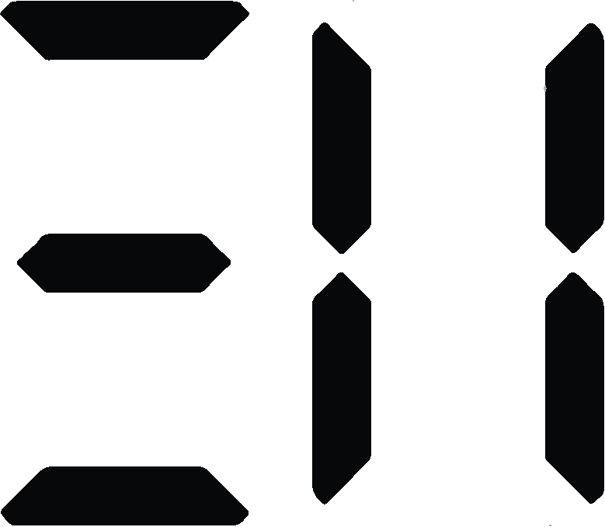
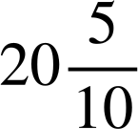
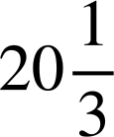
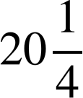
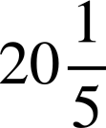
Problem solving with fractions and decimals
Task C: Solving problems with fractions and decimals
Work out the length of ribbon needed for cushions with these dimensions. (All dimensions are in metres)
Width | Length | Converted length / width | Calculation | Length needed
0.64 |  | 0.45 | E.g. 2(0.64 + 0.45) | 2.18 m
1.38 |  | 0.6 | E.g. 2(1.38 + 0.6) | 3.96 m
0.15 |  | 0.12 | E.g. 2(0.15 + 0.12) | 0.54 m
 | 1.07 | 0.35 | E.g. 2(0.35 + 1.07) | 2.84 m
 | 0.97 | 0.875 | E.g. 2(0.875 + 0.97) | 3.69 m
2) A stopwatch measures time in minutes and seconds:
a) Is this more or less than 20.5 minutes?
By how much?
It is 20 seconds more than 20.5 minutes
b) Is this more or less than 20.3 minutes?
By how much?
It is 12 seconds more than 20.3 minutes
c) Which
20:30 is exactly equal to minutes.
time
is
closer
to
minutes?
d) Which
time
is
closer
to
minutes?
20:30 is closer to minutes (as this would be 20:20).
e)
Which
do
you
think
are
further
apart:
20.4 minutes
and
minutes, or
20.5
minutes
and
minutes.
20.5 minutes and minutes are furthest apart. For 20.4 minutes, 20:24 would be showing and, for minutes, 20:15 would be showing. These are nine seconds apart. For 20.5 minutes, 20:30 would be showing and, for minutes, 20:12 would be showing. These are 18 seconds apart.
Mathematics in Education and Industry
v2.2

